Slide 1
Asymptotic Approximations
Week 3

Slide 2
Outline
Asymptotics
Standard Scale
Manipulating Expansions
Asymptotic of Finite Sums
Bivariate Symptotics
Trees
Trees & Forests
Binary Search Trees
Path Length
Other Types of Trees

Slide 3
Notation for Asymptotic Approximations
Definition. Given a function f(N), we write
g(N)=O(f(N)) if and only if |g(N)/f(N)| is bounded from above as N→∞.
g(N)=o(f(N)) if and only if g(N)/f(N)→0�as N→∞.
g(N)∼f(N)�(�)∼�(�) if and only if g(N)/f(N)→1 as N→∞.

Slide 4
The O�- and o�-notations provide ways to express upper bounds (with o� being the stronger assertion), and the ∼-notation provides a way to express asymptotic equivalence.

Slide 5
Notation for approximations
“Big-Oh” approximation
g(N)= f(N)+ o(ಗ(N))
Error will be at most within a constant factor of h(N ) as N increases.
“Little-oh” approximation
g(N)= f(N)+ o(ಗ(N))
Error will decrease relative to h(N ) as N increases.
“Tilde” approximation
g(N) ~ f(N)
Weakest nontrivial o-approximation.

Slide 6
Standard Scale
Definition: A decreasing series gk(N) with gk+1(N) = o(gk(N )) is called an asymptotic scale.
The series
f(N) ~ c₀g0(N)+ c₁g1(N)+ c₂g2(N)+ .. .
is called an asymptotic expansion of f. The expansion represents the collection of formulae
f(N) = o(gO(N))
f(N)= c_{O}gO(N)+ o(g1(N))
f(N)= c_{O}gO(N)+ c₁g1(N)+ o(g2(N))
f(N)= c_{O}gO(N)+ c₁g1(N)+ c₂g2(N)+ o(g3(N))
.
The standard scale is products of powers of N, log N, iterated logs and exponentials.
Typically, we:
use only 2, 3, or 4 terms (continuing until unused terms are extremely small)
use ~-notation to drop information on unused terms.
use O-notation or o-notation to specify information on unused terms.
Methods extend in principle to any desired precision.

Slide 7
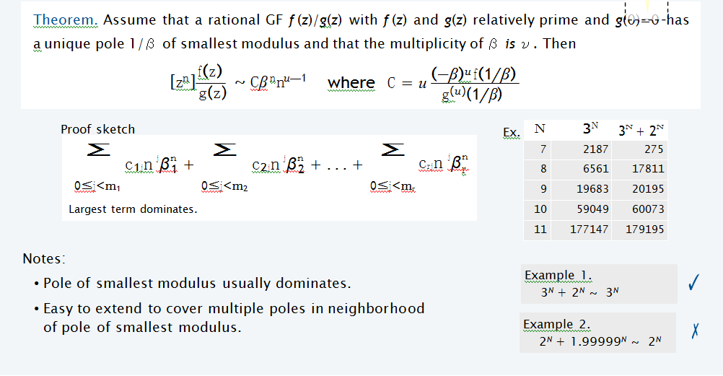

Slide 8
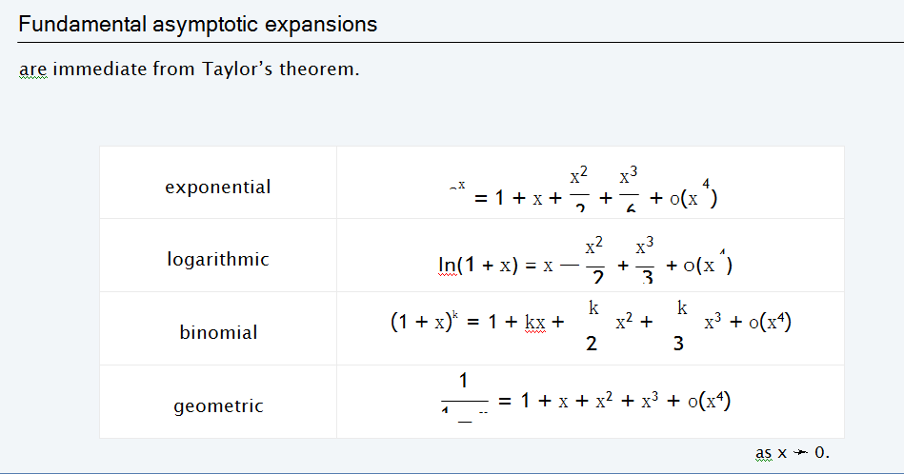

Slide 9
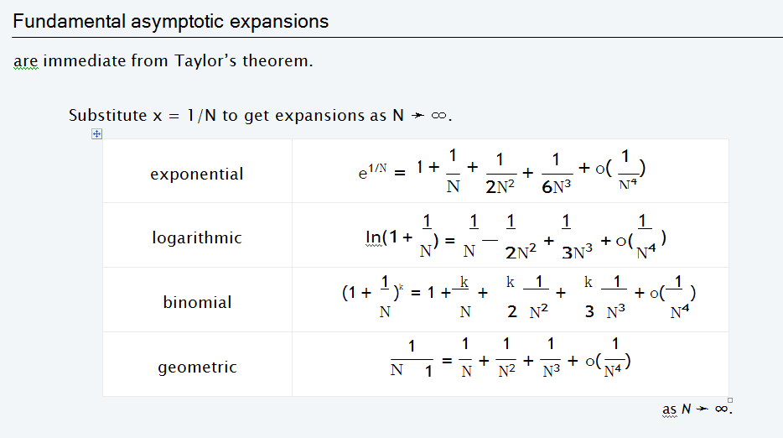

Slide 10
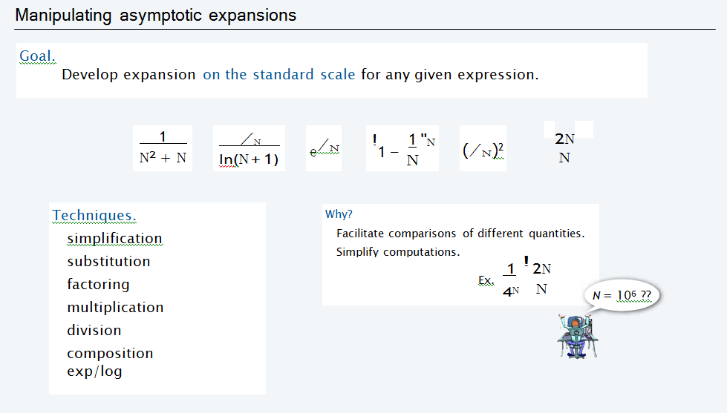
Manipulating Expansions

Slide 11
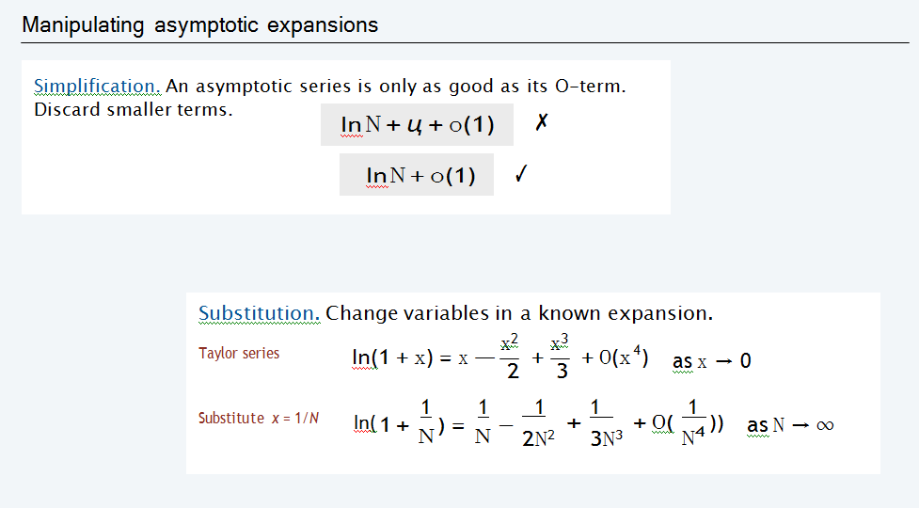

Slide 12
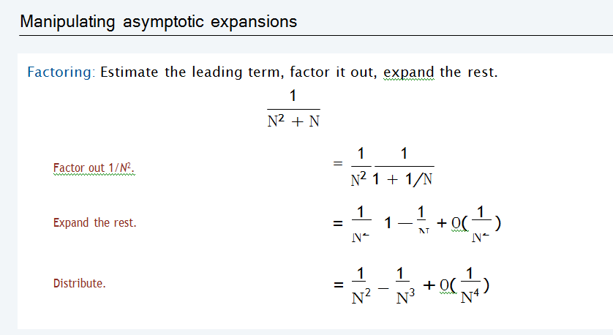

Slide 13
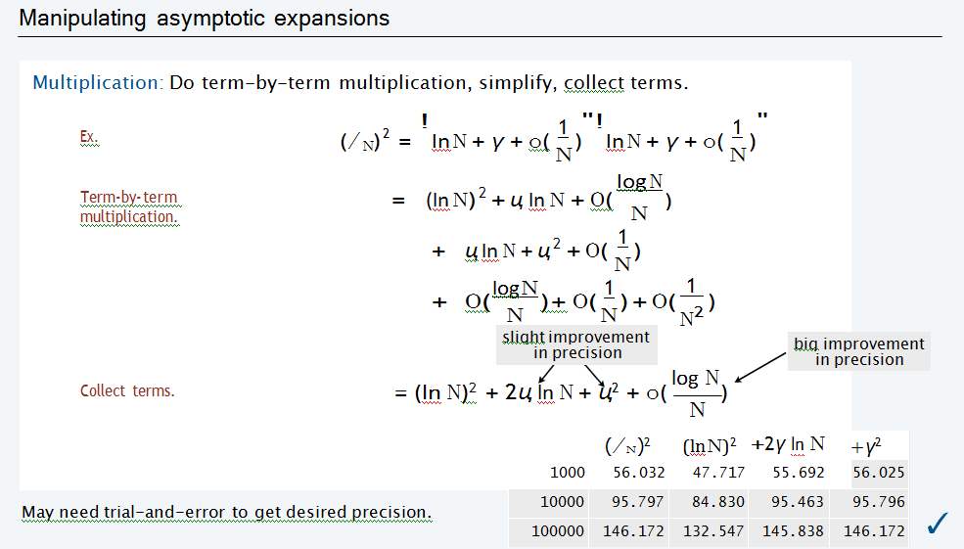

Slide 14
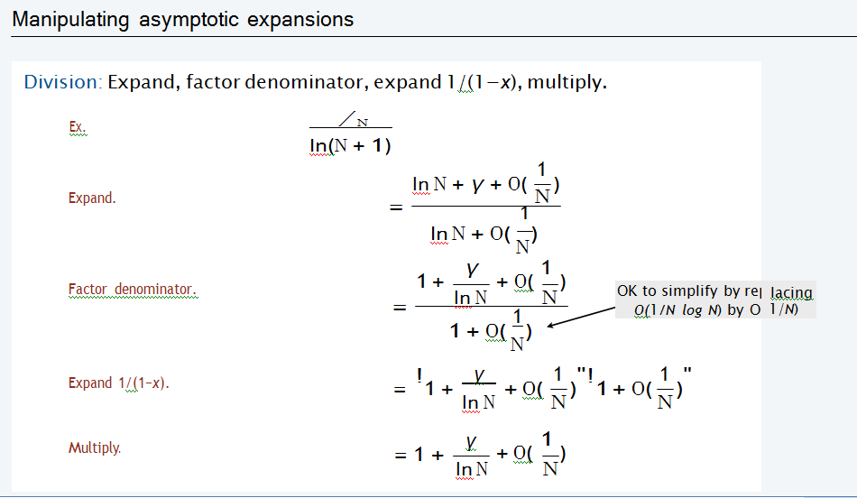

Slide 15
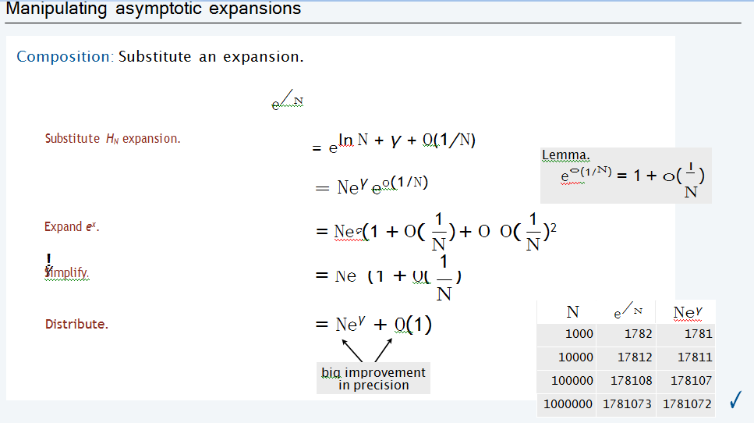

Slide 16
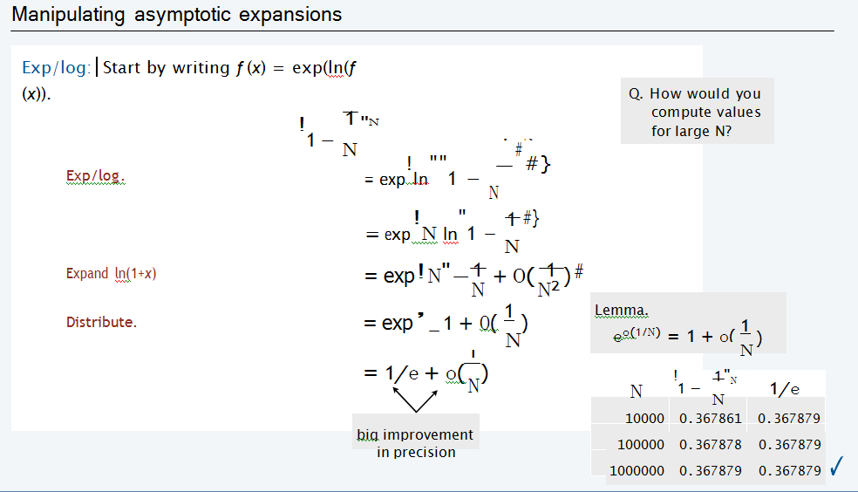

Slide 17
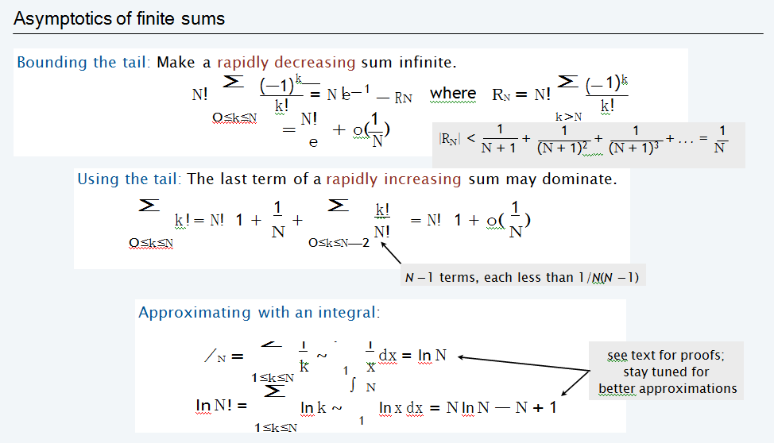
Asymptotic of Finite Sums

Slide 18
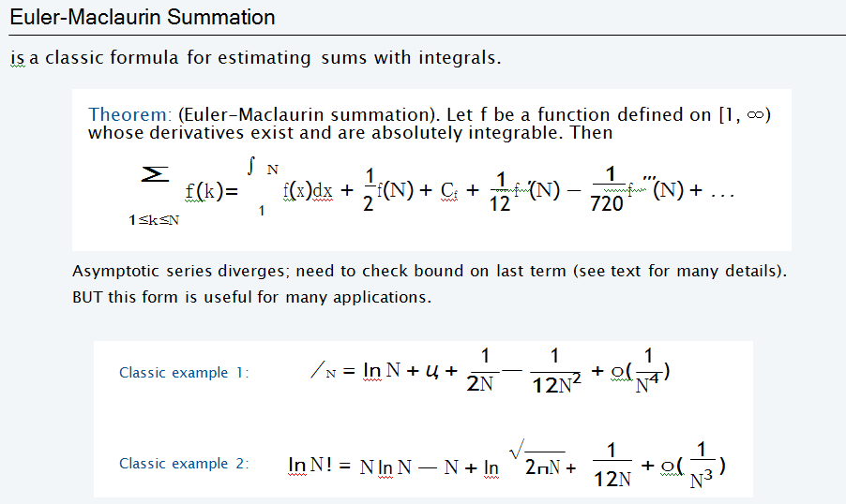

Slide 19
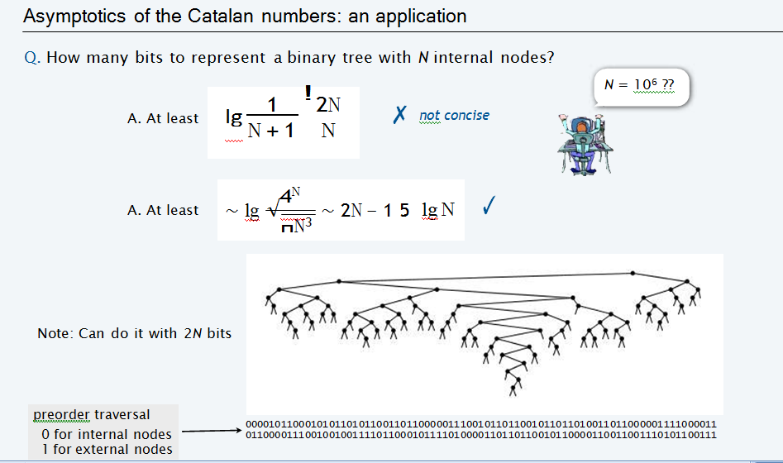

Slide 20
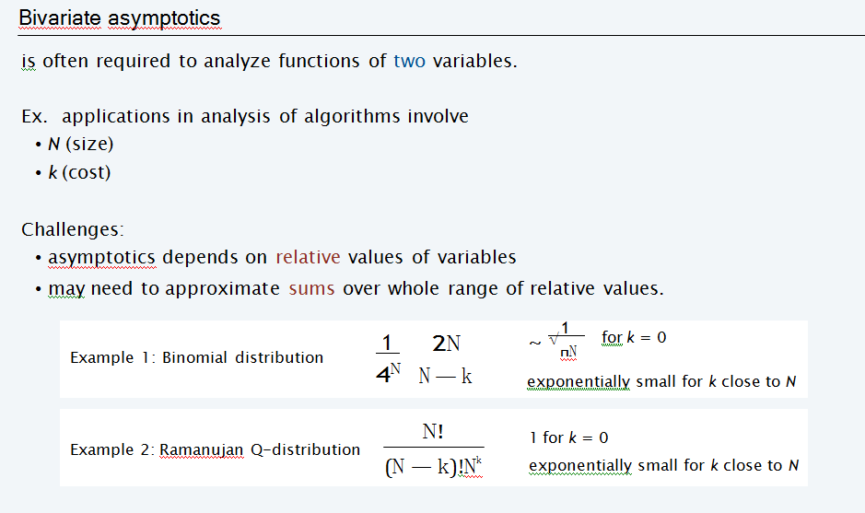

Slide 21
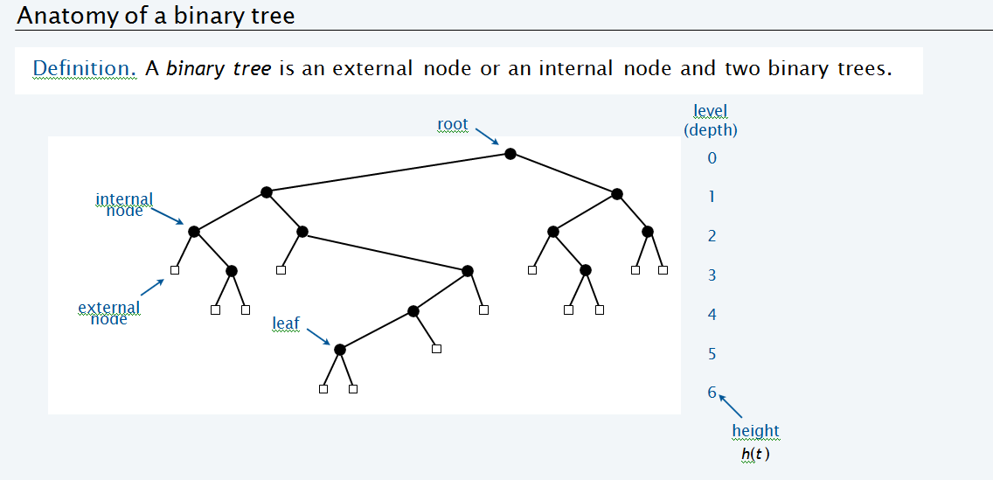
Trees: Trees & Forests

Slide 22
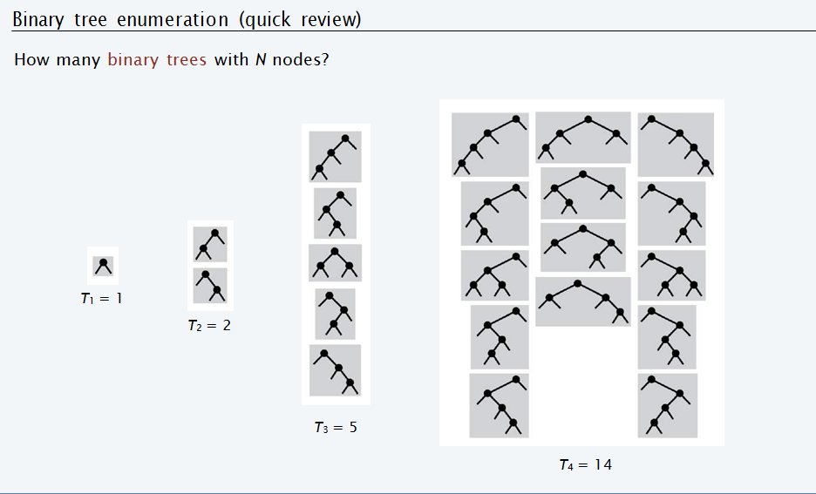

Slide 23
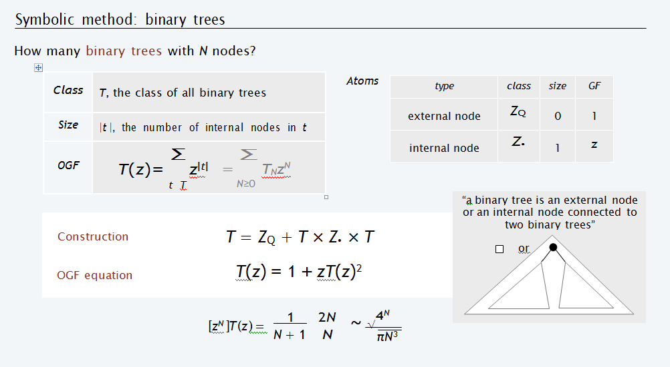

Slide 24
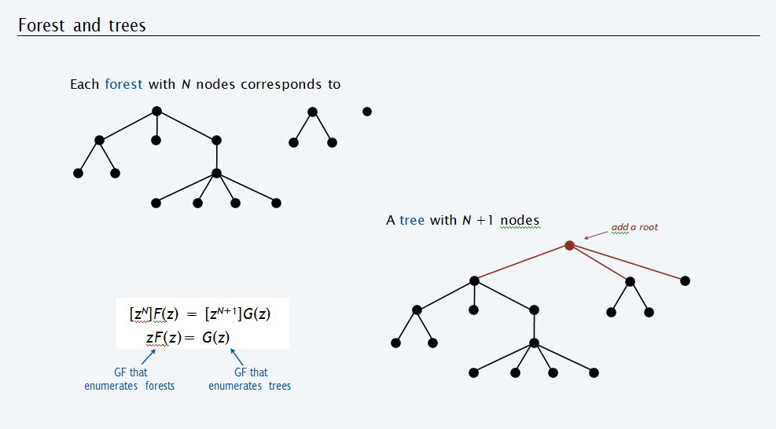

Slide 25
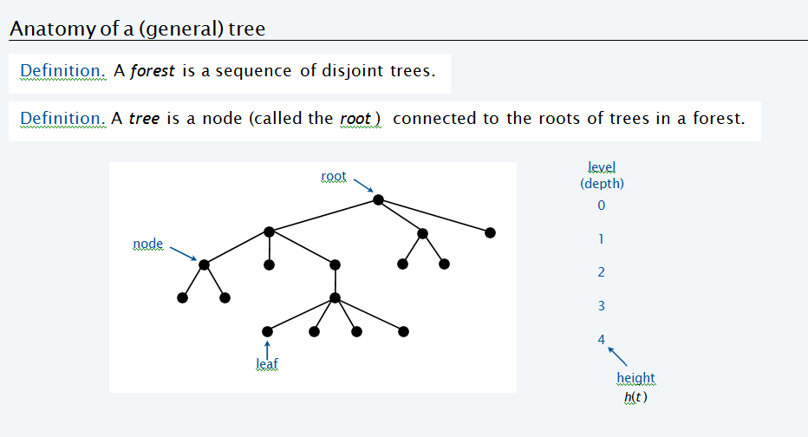

Slide 26
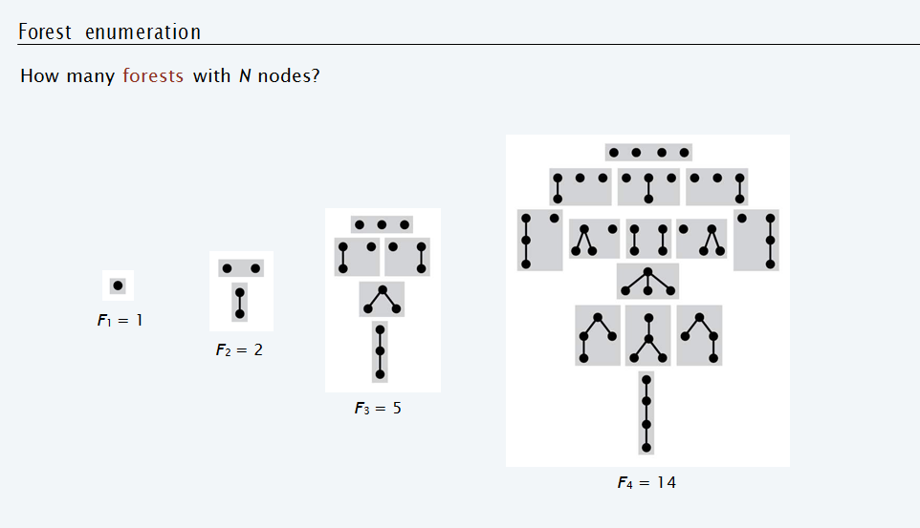

Slide 27
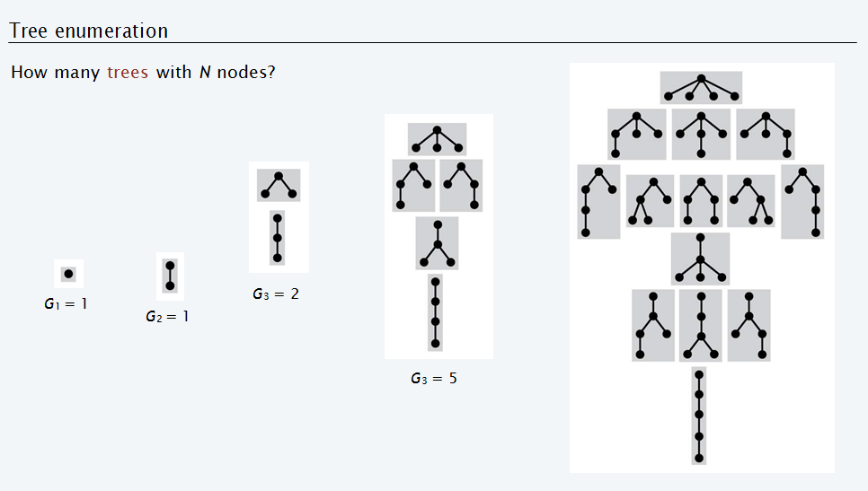

Slide 28
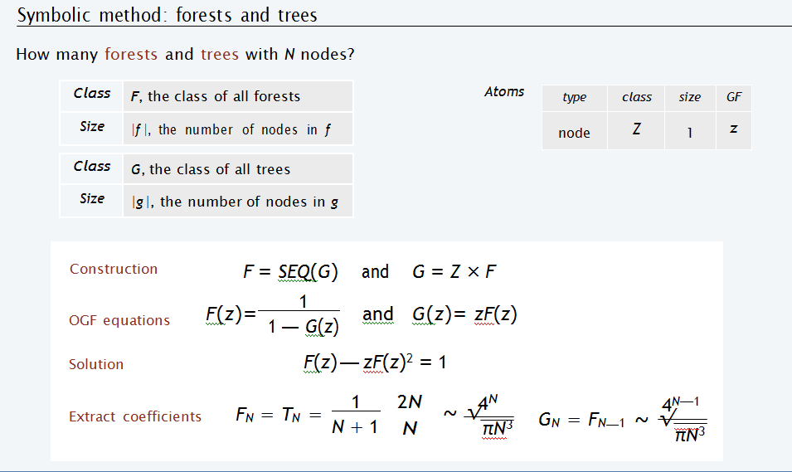

Slide 29
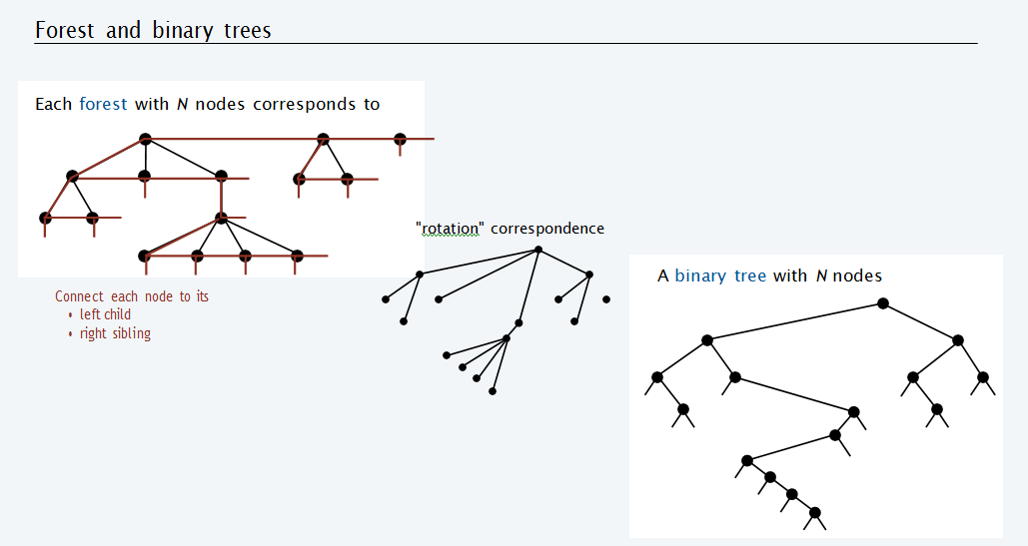

Slide 30
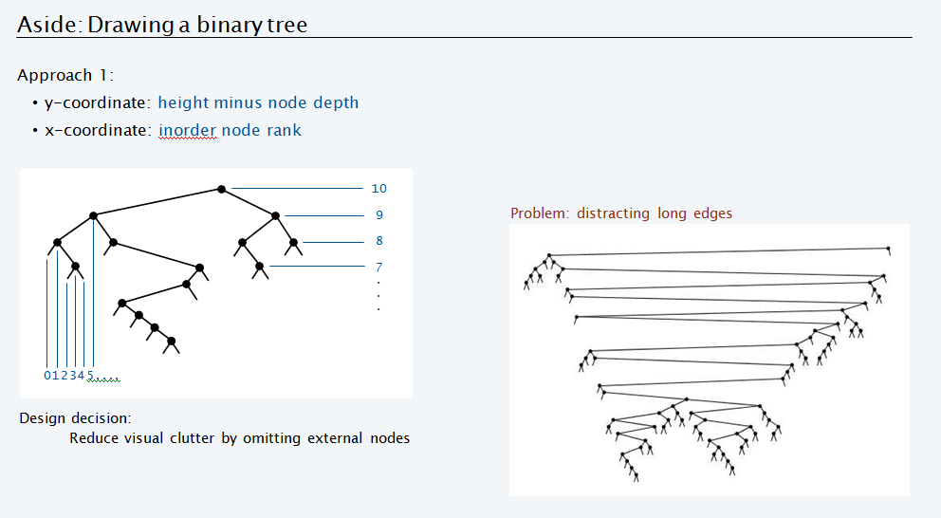

Slide 31
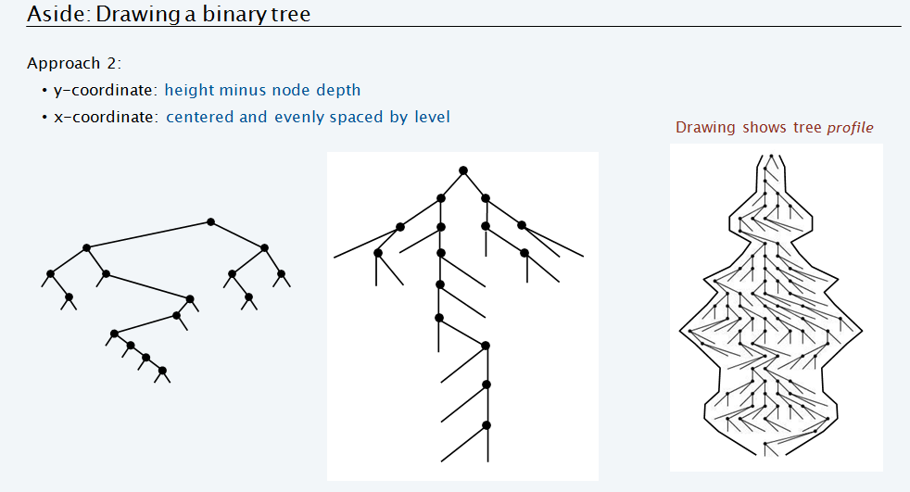

Slide 32
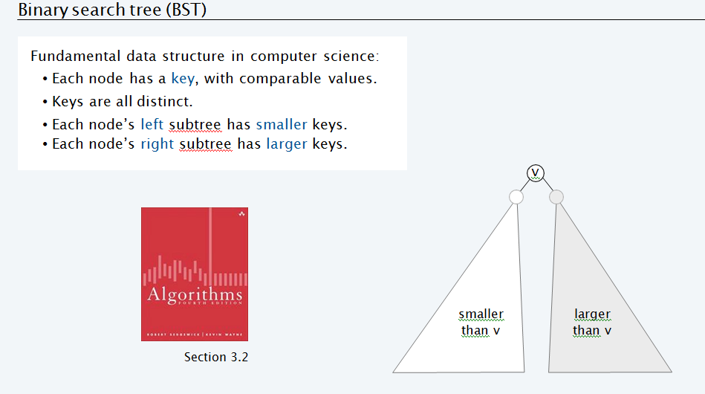
Binary Search Tree(BST)

Slide 33
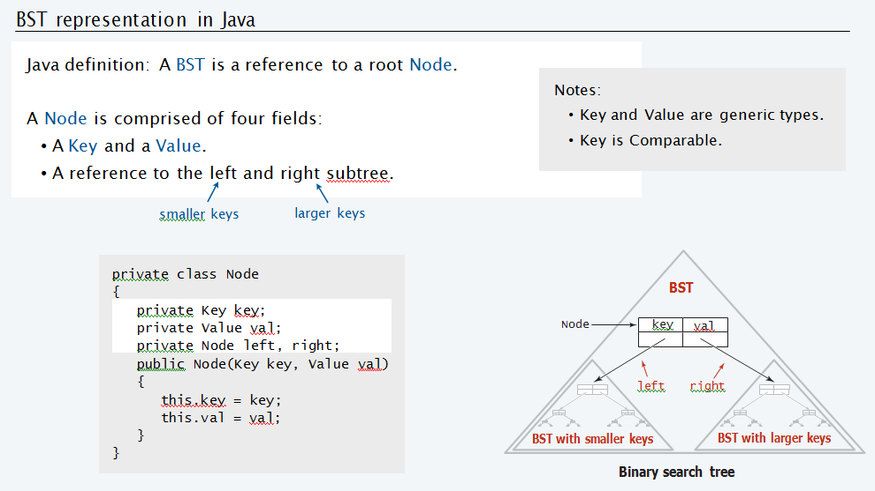

Slide 34
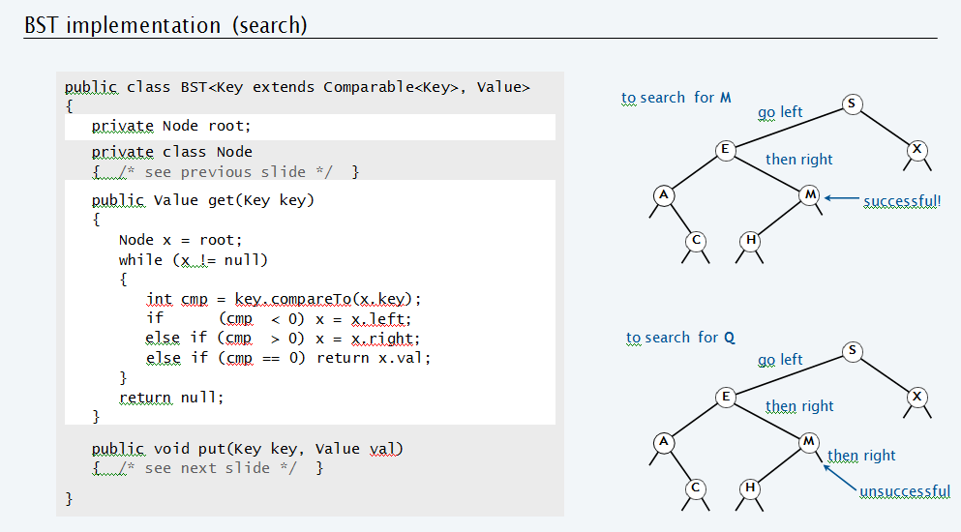

Slide 35
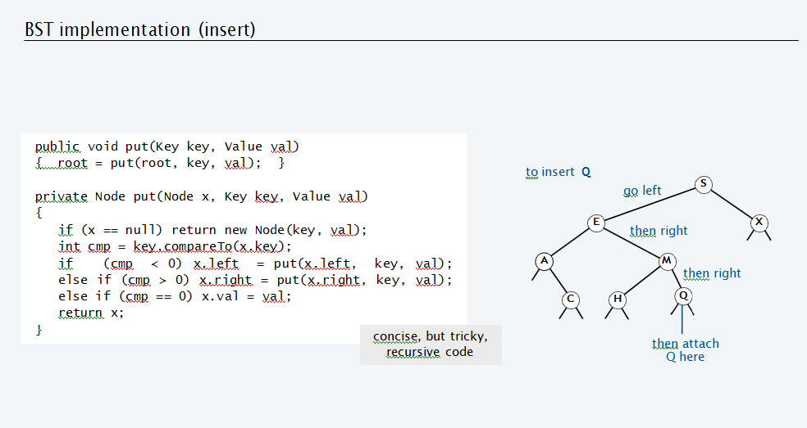

Slide 36
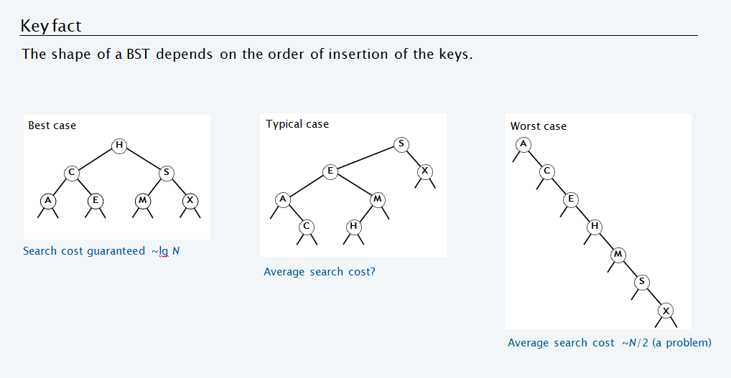

Slide 37
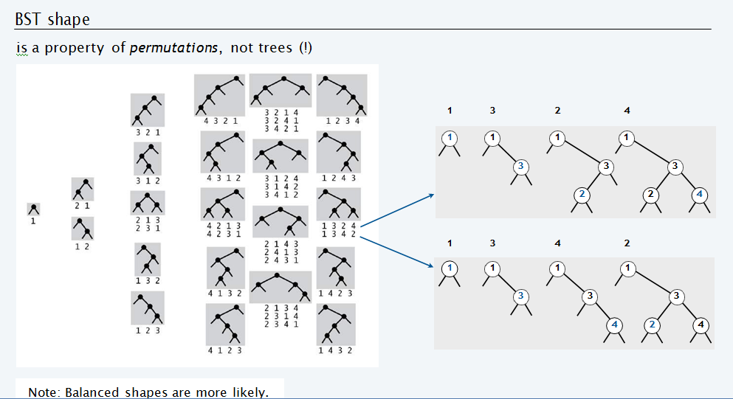

Slide 38
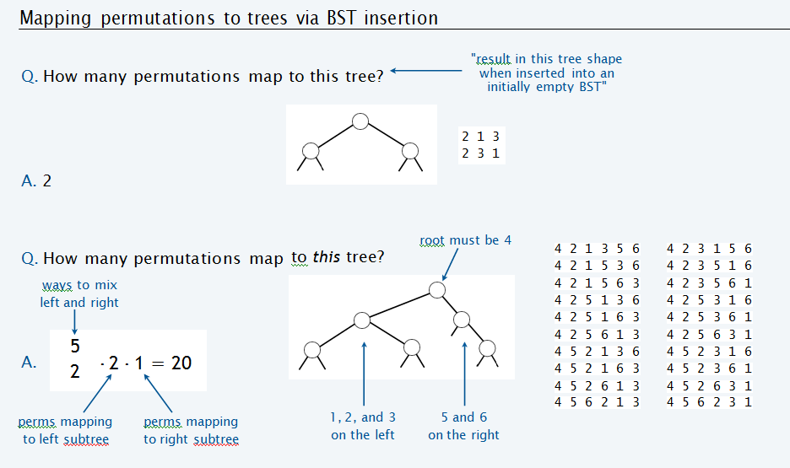

Slide 39
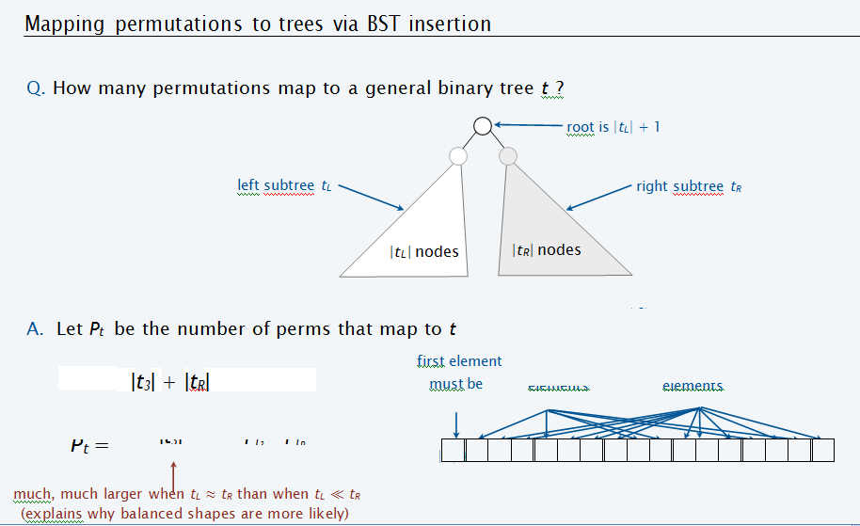

Slide 40
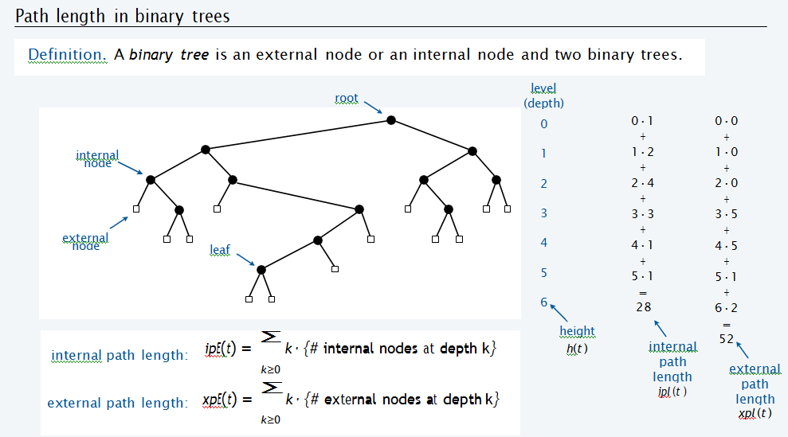
Path Length in BST

Slide 41
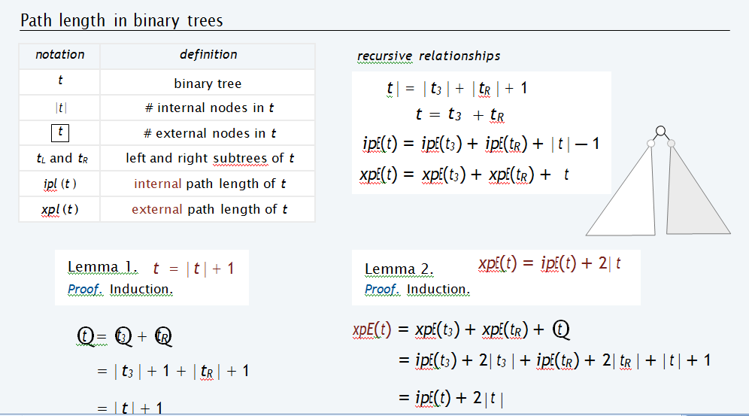

Slide 42
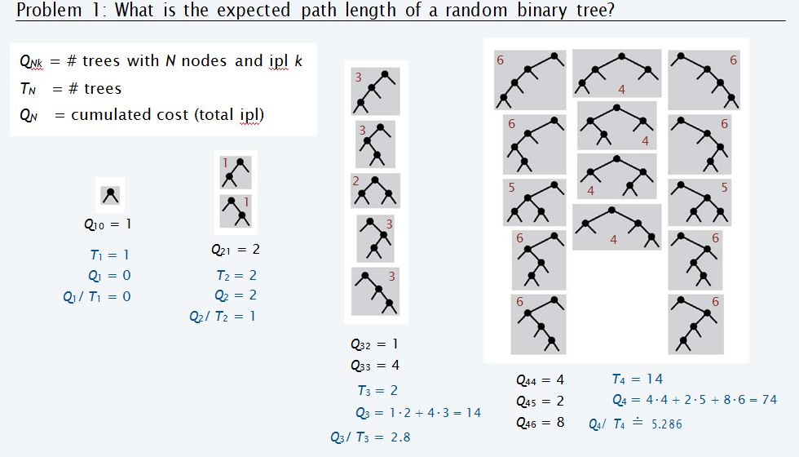

Slide 43
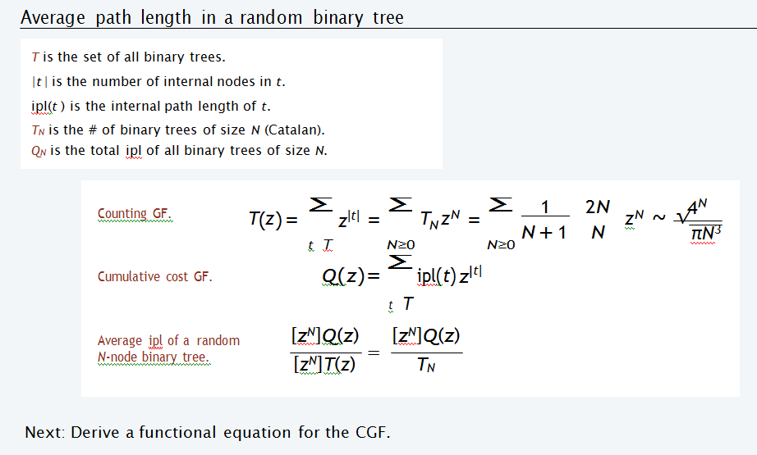

Slide 44
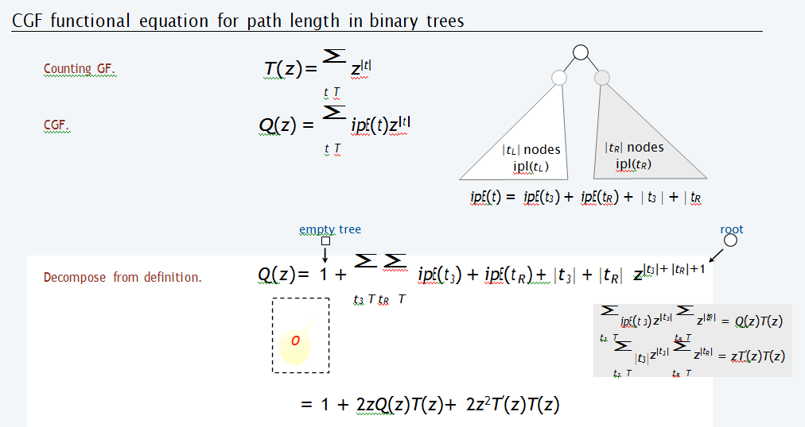

Slide 45
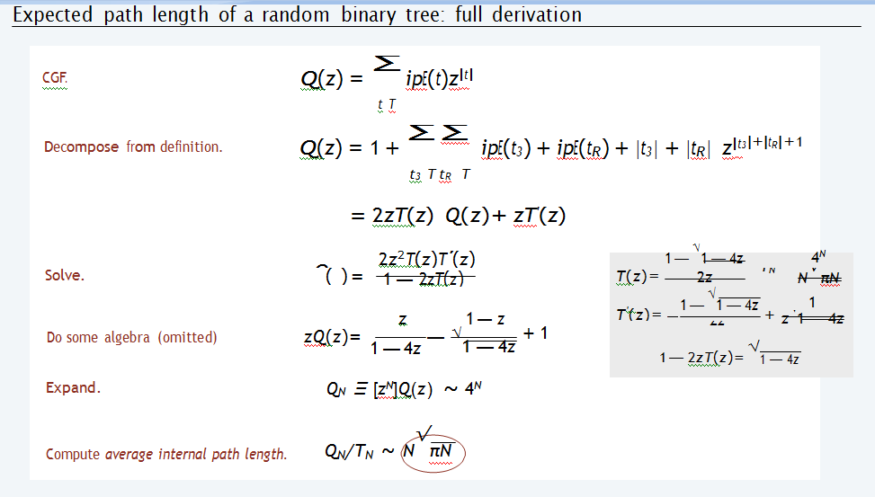

Slide 46
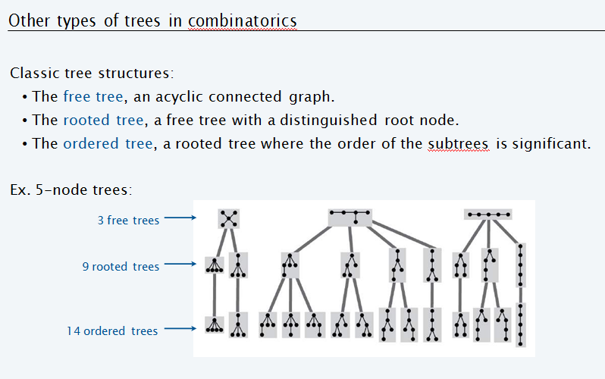
Other Types of Trees

Slide 47
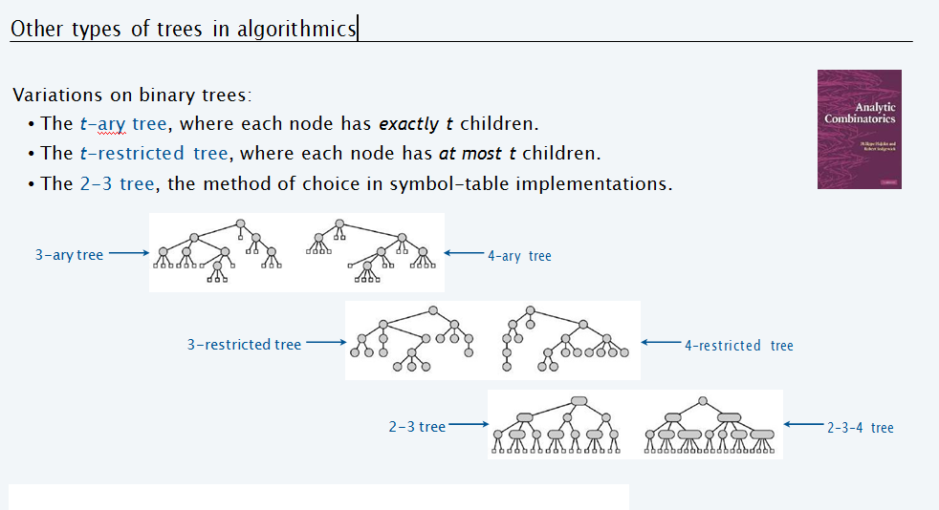

Slide 48
